Slide 1
Smart Home Energy Management System Using Reinforcement Learning
CSE4037 - Reinforcement Learning Lab
Group:
21BCE8498 - Vineet Raval
21BCE8549 - Kushank Jain
21BCE8565 - Yash Sawrikar

Slide 2
OVERVIEW AND MOTIVATION
Dynamic Response (DR) serves as a pivotal mechanism within Smart Home Energy Management Systems (SHEMS) to harmonise electricity supply and demand, especially during periods of peak energy consumption.
SHEMS significantly contributes to environmental sustainability by reducing carbon footprint.
Users benefit from Electricity Bill Optimisation through DR implementation.
Reinforcement Learning (RL) models, known for their adept decision-making capabilities, empower SHEMS by resolving challenges without a priori knowledge of the environment (model-free method).
Emphasis on User Comfort and Satisfaction is prioritised in DR strategies.

Slide 3
Problem Statement
The core objective of this research endeavour is to pioneer the development of a cutting-edge Smart Home Energy Management System (SHEMS) poised to revolutionise energy consumption dynamics within residential settings.
SHEMS is designed to ingeniously optimise energy utilisation by homeowners, harnessing the synergy between electricity grid supply and a myriad of home appliances.
Through sophisticated algorithms and intelligent automation, SHEMS empowers homeowners to achieve unprecedented levels of energy efficiency and cost savings while simultaneously reducing environmental impact.

Slide 4
Reinforcement Learning
Reinforcement learning is a type of machine learning where an agent learns to make decisions by taking actions in an environment to achieve maximum cumulative reward.
It differs from supervised learning in that it does not require labeled input/output pairs and explores instead of being trained with complete knowledge of the environment.

Slide 5
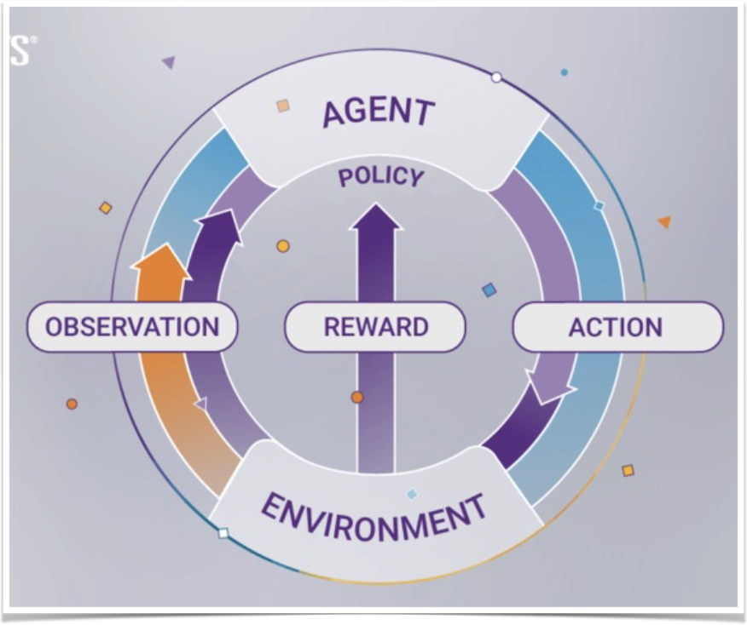
Benefits of using Reinforcement Learning in Smart Home Energy Management
Optimization of Energy Usage
Reinforcement learning enables the system to optimize energy consumption based on real-time data, reducing waste and saving costs.
Adaptability to User Behaviour
The system can learn from user habits and preferences to adjust energy usage patterns, maximising comfort without sacrificing efficiency.
Dynamic Response to Changing Conditions
Reinforcement learning allows the system to adapt quickly to fluctuations in energy availability and demand, ensuring optimal performance.

Slide 6
Fuzzy Reasoning
Fuzzy reasoning, also known as fuzzy logic, is a computational method designed to handle ambiguity and imprecision in decision-making processes.
Unlike classical logic, which categorises assertions as either true or false, fuzzy logic introduces the concept of degrees of truth, ranging from 0 to 1. This enables the representation and manipulation of ambiguous or uncertain information.

Slide 7
Why Fuzzy Reasoning?
Fuzzy logic is particularly advantageous in situations where traditional binary logic systems may not adequately capture the complexity or ambiguity of real-world scenarios. Here's why we might choose to use fuzzy logic in the context of smart home energy management systems:
Ambiguity and Uncertainty
Flexibility and Adaptability
Granularity and Precision
Human-Centric Design
Robustness to Noise and Variability

Slide 8
Proposed Architecture of SHEMS
Smart Devices
﻿﻿Central Controller
﻿﻿Communication Protocols
﻿﻿User Interface
﻿﻿Home Appliances

Slide 9
Proposed Functionalities of SHEMS
Real-time Energy Monitoring
﻿﻿Appliance Control
﻿﻿Logging
﻿﻿Data Analysis
﻿﻿Energy Optimisation
﻿﻿Notification to user

Slide 10
Methodology Used
Q - Learning

Slide 11
Q - Learning
Q-learning: A method in reinforcement learning for maximising cumulative rewards over time.
Core Idea: Q-values represent expected rewards for actions in given states.
Balancing Act: Balances exploration (trying new actions) and exploitation (using known optimal actions).
Convergence: With exploration and learning, Q-learning converges to the best strategy.
Applications: Used in robotics, game playing, and decision-making tasks for its simplicity and effectiveness.

Slide 12
Q-Learning for Smart Home Energy Management
inputs:
Power Demand: Reflects the current energy requirements of the home.
Electricity Cost: Represents the cost of electricity consumption.
Objective:
Optimise energy usage while minimising electricity costs.
Q-Learning Approach:
Define states based on power demand and electricity cost.
Determine actions to adjust energy usage accordingly.
Develop a reward function to incentivise cost-efficient energy management.
Learning Process:
Explore different actions initially to learn their impact.
Exploit learned knowledge to make optimal decisions over time.
Implementation:
Update Q-values based on observed rewards and states.
Use learned Q-values to guide energy management decisions.
By employing Q-learning in Smart Home Energy Management, we enable dynamic optimisation of energy usage to minimise costs while meeting household demands.

Slide 13

Proposed Flowchart
Reward Matrix
Generation using
Power Demand & electricity cost
States Generation using Power Demand & electricity cost
Q Learning Algorithm implementation using reward and states matrix
Actions taken based on Q Matrix

Slide 14
Demand Response Strategy Using Q-Learning Model
Data of Shiftable Home Appliances
Appliance | Rated Power (W) | Duration Cycle (min) | Priority Order
Washing Machine | 500 | 60 | 1
Water Pump | 1800 | 180 | 2
Dishwater | 800 | 60 | 3
Tumble dryer | 750 | 120 | 4
Microwave | 1200 | 60 | 5
Electric Water Heater | 2000 | 120 | 6

Slide 15
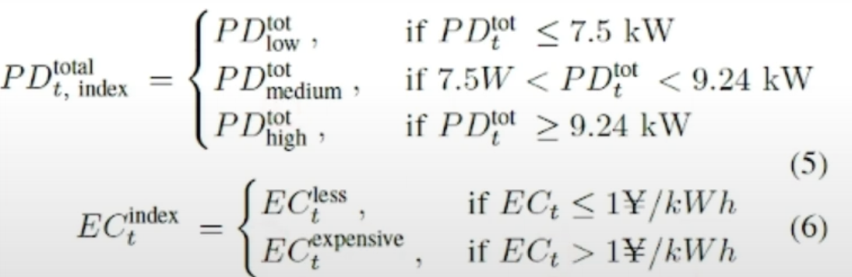
Demand Response Strategy Using Q-Learning Model
Power Demand: $PD_{t}^{tot}=\underset{x=1}{∑}E_{t}^{tot}*I_{t}^{X}$

Slide 16
Demand Response Strategy Using Q-Learning Model
Index of States based on Power Demand & Electricity Cost
Power Demand | Electricity Cost | State
Low | Less | 1
Low | Expensive | 2
Medium | Less | 3
Medium | Expensive | 4
High | Less | 5
High | Expensive | 6

Slide 17


Demand Response Strategy Using Q-Learning Model
Transfer
Power Demand
SHEMS
Fill Valley
Electricity Cost
Stay Idle

Slide 18
Demand Response Strategy Using Q-Learning Model
Fuzzy Rules of FIS
Power Demand | Electricity Cost | Transfer | Fill Valley | Stay Idle
Low | Less | PA | SFA | FA
Low | Expensive | PA | FA | FA
Medium | Less | PA | FA | SFA
Medium | Expensive | PA | FA | SFA
High | Less | PA | PA | SFA
High | Expensive | SFA | PA | PA

Slide 19
Q Learning Algorithm
Initialise $Q(s_{t},a_{t}),s∀S,a∀A$
Set μ & α parameters & rewards in matrix as in Table 3
For each time step t do
Choose random initial state
While hour=1:24
Determine all available actions & select random action for current state
Execute selected action $a_{t}$ and observe the state $s_{s+t}$ & numerical reward r($a_{t},s_{t}$)
Determine the maximum Q-value for next state in Q-matrix
Update the Q($a_{t},s_{t}$)
Set the next state as current state
End While
End For

Slide 20
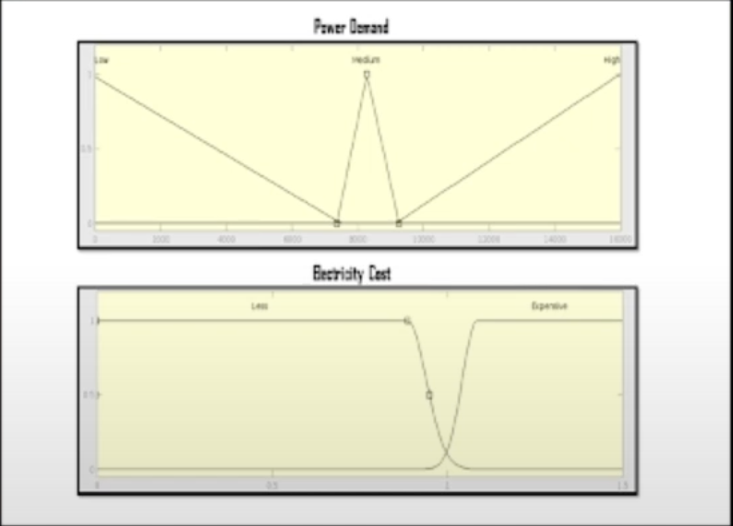
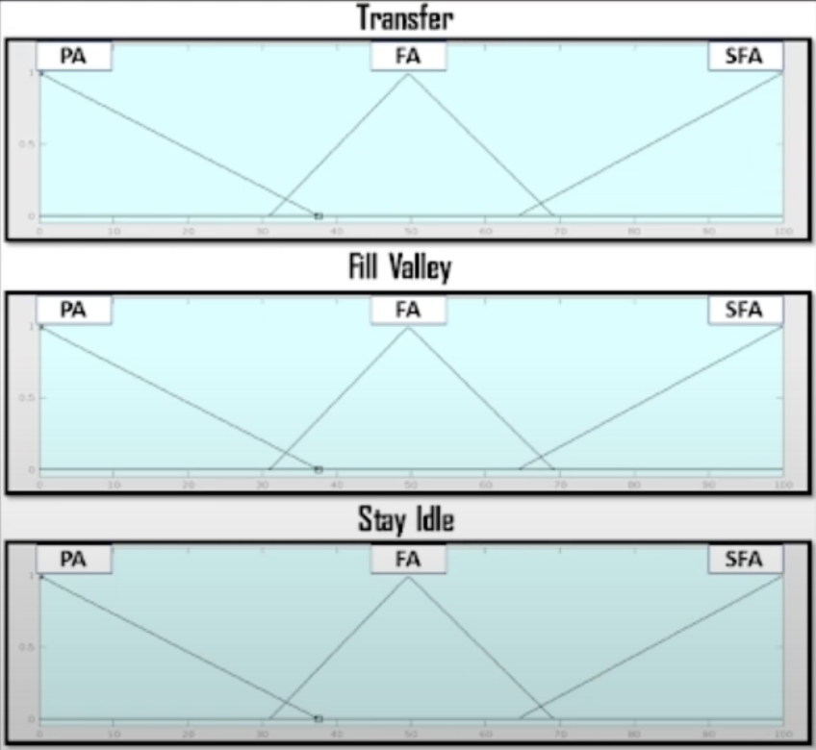
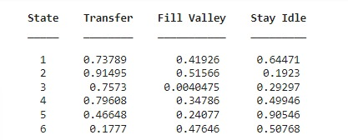
Results: Reward Matrix Output
Inputs
Actions
Reward Matrix

Slide 21
Results: Converged Q Matrix
Converged Q Matrix (1000 iterations)
State Index/ Action | Transfer | Fill-Valley | Stay Idle
1 | 10.724 | 15.263 | 13.737
2 | 13.027 | 12.801 | 10.573
3 | 11.363 | 14.737 | 13.263
4 | 12.709 | 13.363 | 11.157
5 | 5.4874 | 15.737 | 8.8704
6 | 13.737 | 12.594 | 12.196

Slide 22
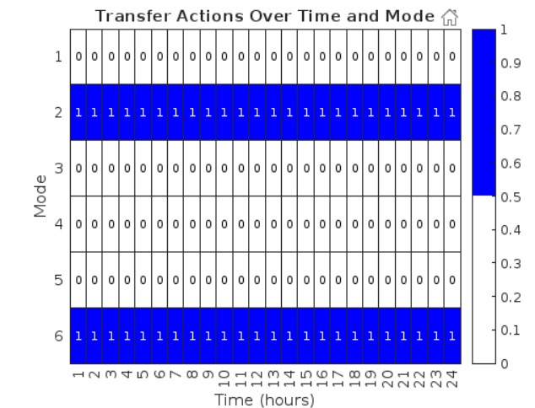
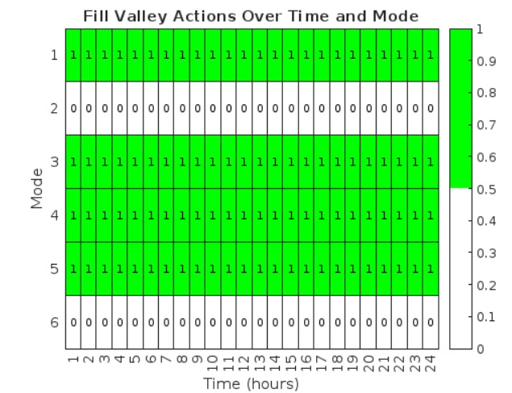
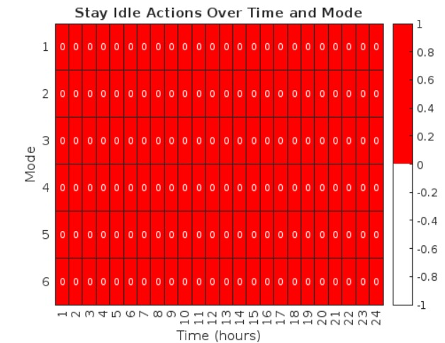
Results: Actions Over Time & Mode

Slide 23
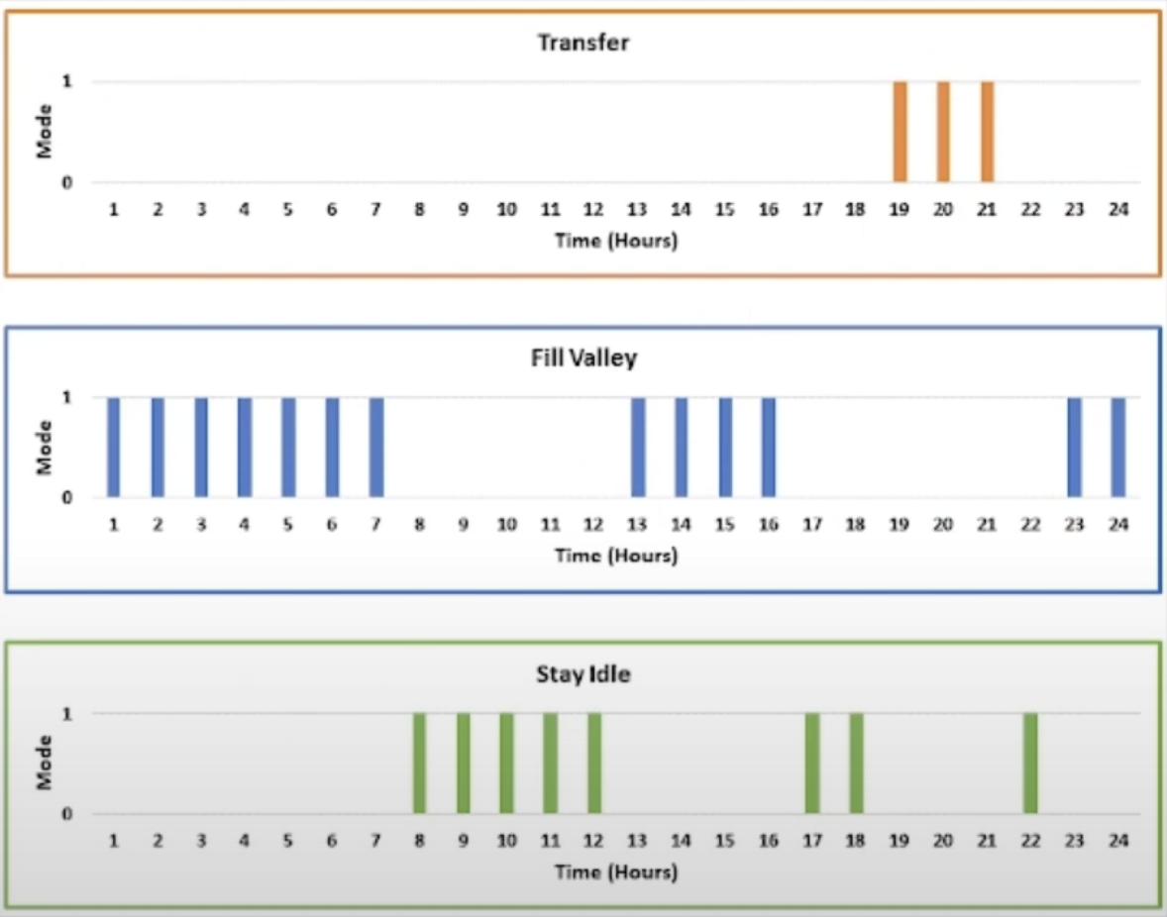
Results: Actions taken based on Q-Matrix

Slide 24
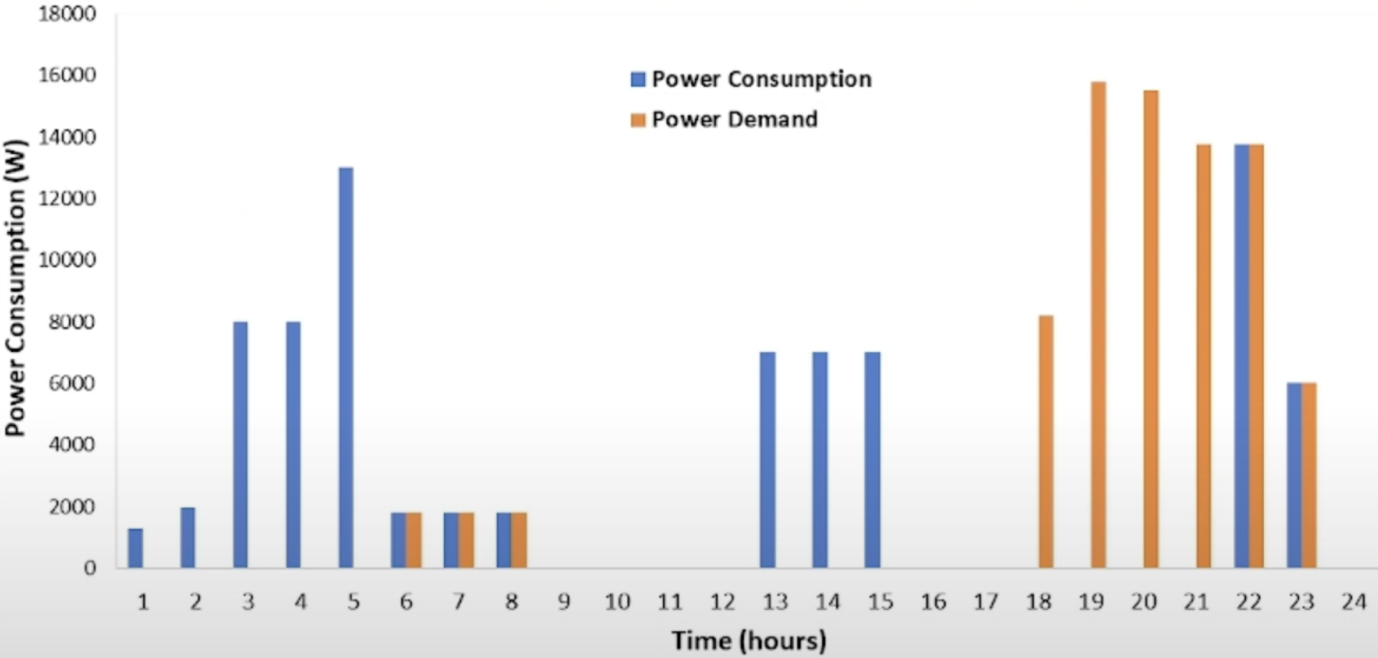
Results: Power Consumptions Profile After Optimisation
Total Cost Reduction = 38.28%

Slide 25
Conclusion
This study proposed a DR strategy to shift load demand of a smart home from peak hours to off-peak hours in response to user’s propriety of home appliances & electricity cost signal.
Only controllable home appliances are considered.
The suggested method use one agent to operate 6 home appliance using fuzzy reasoning for a specific state.
The findings indicate that the cost of the electricity bill was reduced by 38.28%

Slide 26
Future Work
This research can be enhanced by incorporating numerous novel perspectives as mentioned below:
Integration of DERs in smart home can help build a more optimised smart home, decreasing electricity bill & providing more stability to the grid.
The use of RL in multi-agent systems that may engage in demand response must be further investigated.
A comparison between results of meta heuristics techniques & proposed RL technique can be carried out.

Slide 27
References
Review on Home Energy Management System Considering Demand Responses, Smart Technologies, and Intelligent Controllers
Demand Response for Home Energy Management Using Reinforcement Learning and Artificial Neural Network
Reinforcement Learning-Based Energy Management of Smart Home with Rooftop Solar Photovoltaic System, Energy Storage System, and Home Appliances
Reinforcement learning for demand response: A review of algorithms and modelling techniques
Deep reinforcement learning for home energy management system control
Systematic Review on Deep Reinforcement Learning-Based Energy Management for Different Building Types
Home Energy Management System based on Deep Reinforcement Learning Algorithms

Slide 28
Thank You

